Slide 2
Distributed System in Jenkins

Slide 3

By the end of this lesson, you will be able to:
Explain distributed architecture
Set up master/slave Jenkins instances
Generate and assign tasks to slave machines
Explain SSH and Java Web Start processes to start the slave machine

Slide 4
Introduction to Distributed Architecture

Slide 5
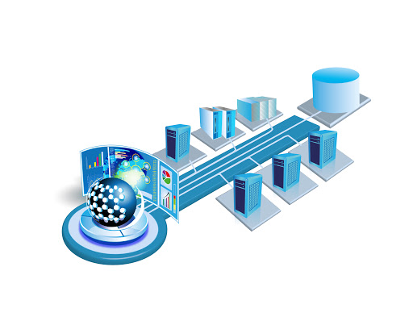
Introduction
One of the more important features of Jenkins is the capability to execute and dispatch build jobs over a large number of systems.
Build servers are created to either share the load across multiple machines, or to run build jobs in different environments.
The need of build servers can vary during the project life cycle.
For example, if you are working with product release cycles, run a higher number of builds jobs at the end of the cycle for comprehensive tests.
Notes:
Trainer Notes:
Explain all the points to the learner

Slide 6




Jenkins Distributed Build Architecture
The role of Jenkins master’s job is to schedule build jobs, assign builds to the slaves, record and generate build results.
Major characteristics of distributed architecture:
Jenkins master instance can
directly execute build jobs.
Jenkins slaves’ tasks are decided by
the Jenkins master.
Jenkins master-slave
architecture is highly flexible.
A project can run on a particular slave machine, on a particular type of machine, or let Jenkins pick the available slave.
Notes:
Trainer Notes:
Explain all the points to the learner

Slide 7
Jenkins Slave Machine
A slave is a small Java file that runs on a remote machine and is assigned tasks by Jenkins master machine. Major characteristics of a slave machine include:
Slave machines can run on a variety of operating systems.
Slave machines communicate with the master instance through a TCP/IP connection.
The working mechanism of the slave machines depends on the operating system and network architecture.
Notes:
Trainer Notes:
Explain all the points to the learner

Slide 8
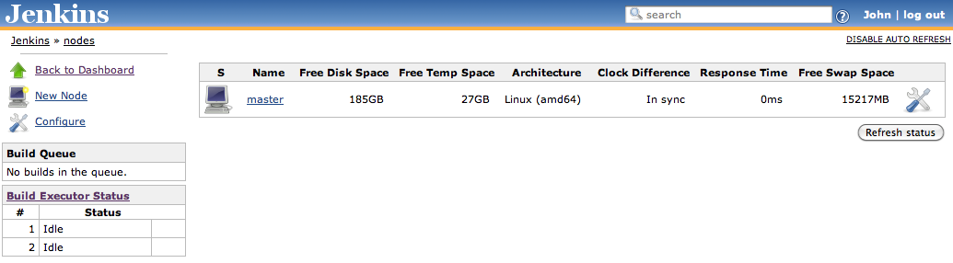
Master/Slave Strategies in Jenkins
A build job, running on a slave machine, is accessible by the end-user. Moreover, the build results always get generated and published on the master server.
Creating a new Jenkins slave node is a straight-forward process and includes the following steps:
Navigate to Manage Jenkins screen and click on Manage Nodes.
Click on New Node.
Notes:
Trainer Notes:
Explain all the points to the learner

Slide 9

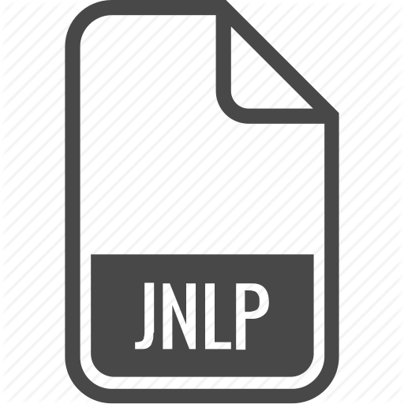


Master/Slave Strategies in Jenkins
The four strategies of Jenkins master/slave architecture are:
Starting the slave machine with SSH connection
Starting the slave machine manually with Java Web Start
Strategies
Installing the slave machine as a Windows service
Starting the slave machine using CLI on the slave machine
Notes:
Trainer Notes:
Explain all the points to the learner

Slide 10
Why Label Node?
Labels are tags to a slave node that allows node categorization in Jenkins.
Importance of labelling include:
Labels give information about the tools supported by a node.
Labels also provide information about the operating system of the node.
Labels can be kept for slaves in different locations due to multiple factors like different datacenters or cloud stack.
Notes:
Trainer Notes:
Explain all the points to the learner

Slide 11
Create Multiple Slave Node
Problem Statement: You are given a project to create and configure a slave node in Jenkins.
Steps to perform:
Spin up a VM to be used as the slave machine.
Install Jenkins on the VM.
Login to Master Node.
Navigate to Manage Jenkins.
Click on Manage Node and Clouds.
Click on New Node.
Provide name, number of executors, root directory path, label, usage, launch method, and WebDir path.
Once the configuration is complete, you can see the slave machine on the dashboard.
Notes:
Trainer Notes:
Explain the objective

Slide 12
Deep Diving Jenkins Master/Slave Architecture

Slide 13
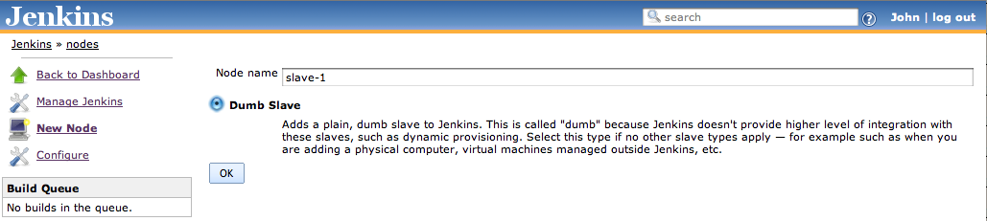
Starting Slave Machine with SSH
This strategy is useful for Unix machines as Jenkins has its own build-in SSH client.
Follow the below steps to create Unix-based slave:
Click on the New Node button.
Enter the name of your slave, and its type.
Notes:
Trainer Notes:
Explain all the points to the learner

Slide 14
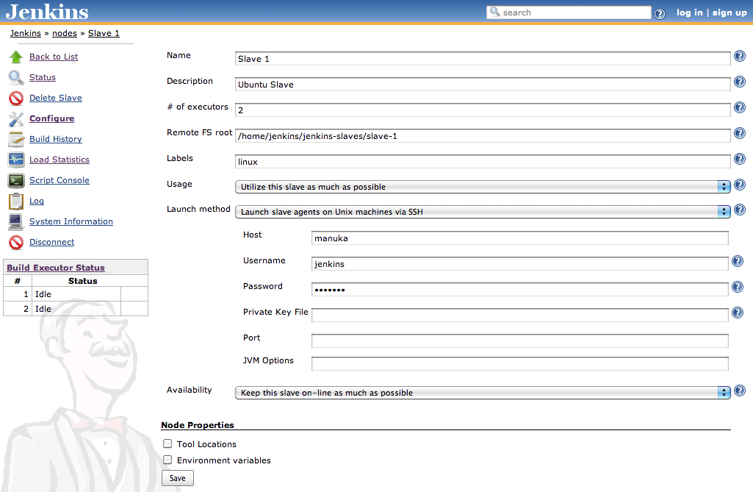
Configuring Slave Machine with SSH
The screenshot given below has the configuration fields of a Jenkins slave node.
Notes:
Trainer Notes:
Explain all the points to the learner

Slide 15
Configuring Slave Machine with SSH
The number of executors field lets you define the number of build jobs the particular node can execute.
Every Jenkins slave node also needs a directory on the slave machine for the slave agent to run build jobs, which can be defined in Remote FS root field.
Labels are useful when the distributed build architecture is complex.
You can define labels or tags to each build node and then configure a build job to run only on a slave node with a particular label.
The Usage field lets you configure the usage of slave by Jenkins.
In the Launch Method field, you can choose the strategy used to start a slave machine.
The Tools Location under Node Properties helps you integrate different JDKs with your node.
Notes:
Trainer Notes:
Explain all the points to the learner

Slide 16
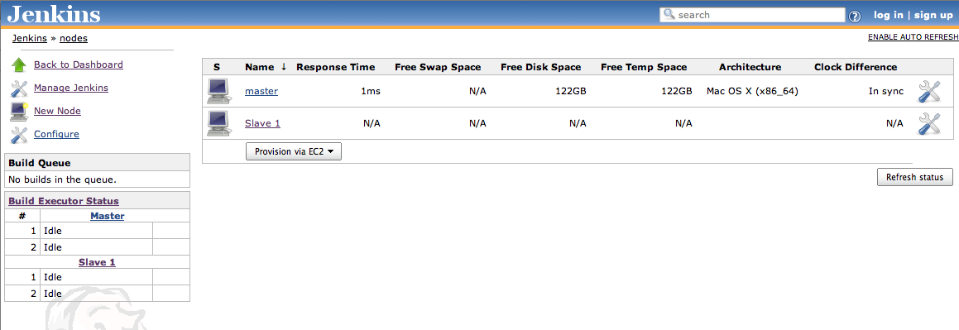
Configuring Slave Machine with SSH
Screenshot of the newly created slave node is shown below:
Notes:
Trainer Notes:
Explain all the points to the learner

Slide 17
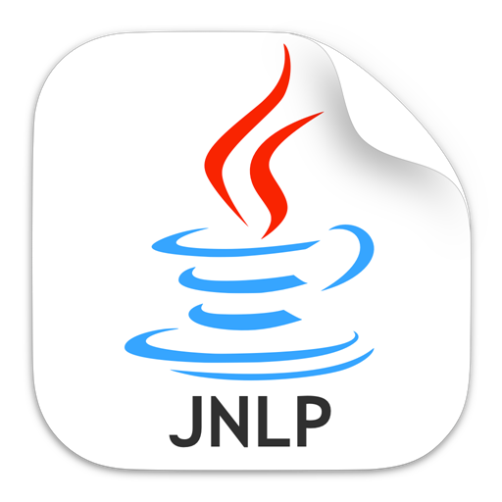
Starting Slave Machine with Java Web Start
Java Web Start is used to connect the server to the slave. For example: If the slave machine is running on another network.
It works no matter what operating system the slave is running on.
It is more commonly used for slaves on windows machine.
However, the limitation of this approach is that slave node cannot be started or restarted automatically by Jenkins.
Notes:
Trainer Notes:
Explain all the points to the learner

Slide 18
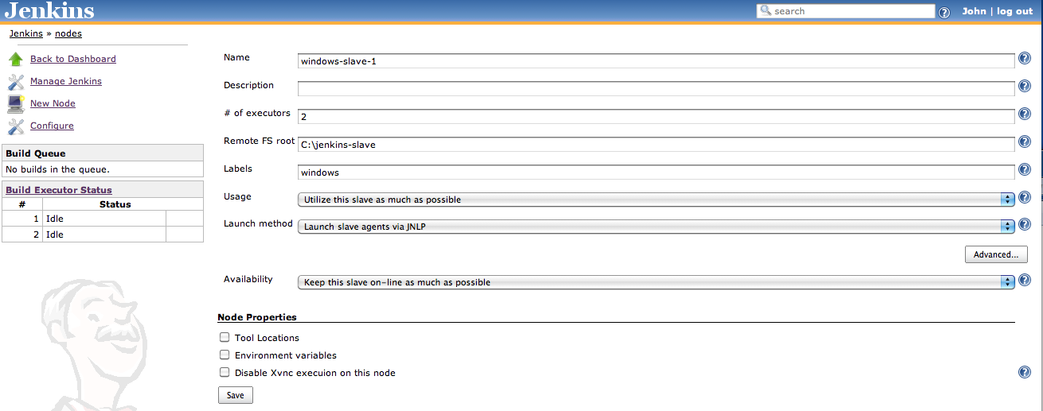
Configuring Slave Machine with Java Web Start
Steps to start a slave node with JNLP are:
Create a new slave node.
Select Launch slave agents via JNLP option in Launch Method field.
If it is a Windows slave node, provide a Windows path to Remote FS.
Notes:
Trainer Notes:
Explain all the points to the learner

Slide 19
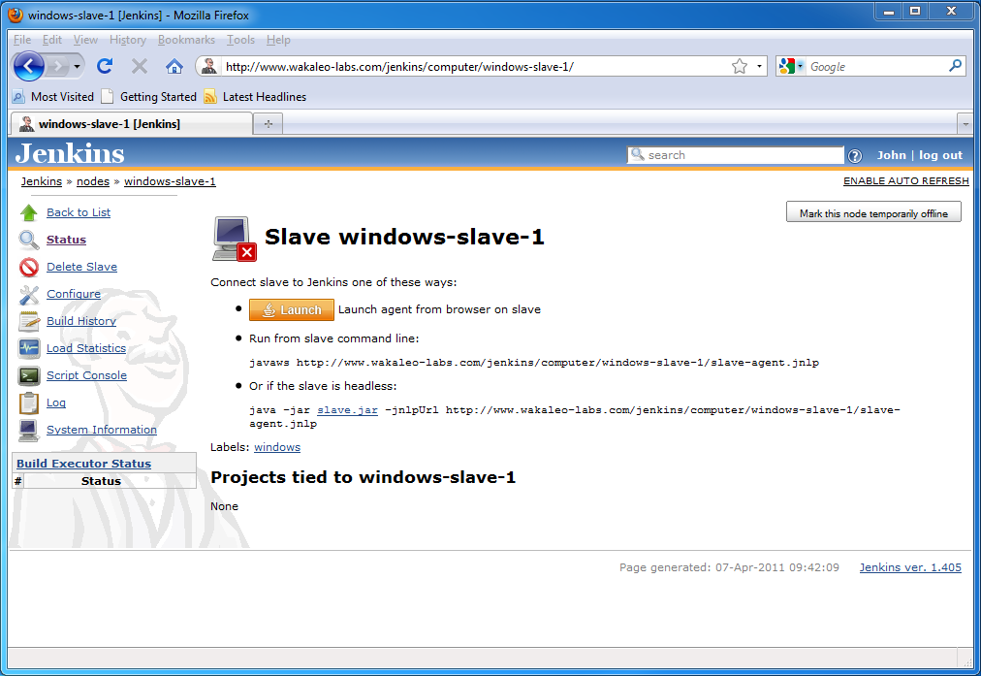
Configuring Slave Machine with Java Web Start
Once you have configured slave node, log on to the slave machine and open the slave node browser screen as shown here:
Click on the orange Launch button to start the node.
Notes:
Trainer Notes:
Explain all the points to the learner

Slide 20
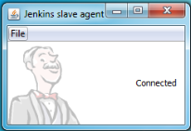
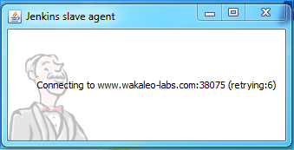
Configuring Slave Machine with Java Web Start
The slave node is opened in a new window as shown in the figure:
It is recommended to use Firefox or Chrome with Java Web Start as Internet Explorer may require additional browser level configurations.
If security is activated on the Jenkins server, Jenkins will communicate with the slave on a specific nonstandard port.
If there is any issue with the port, slave won't open and it prompts the following message on the screen:
Notes:
Trainer Notes:
Explain all the points to the learner

Slide 21
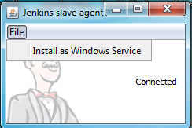
Installing a Jenkins Slave as a Windows Service
Once the slave is up and running on the Windows machine, you can also install it as a Windows service by selecting the Install as Windows Service menu option in the File menu of the slave agent window
Jenkins slave node will start automatically whenever the machine starts up after the installation.
Notes:
Trainer Notes:
Explain all the points to the learner

Slide 22
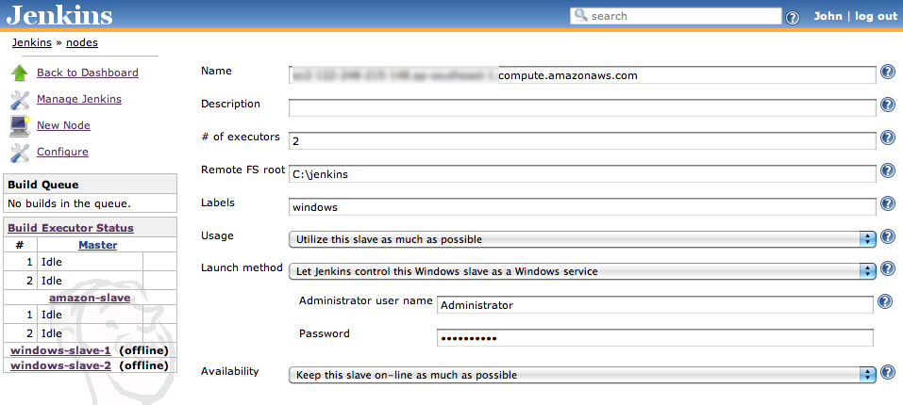
Starting a Windows Slave as a Remote Service
Jenkins can be also used to control and operate remotely on the slave machine.
While creating a node, choose Let Jenkins control this Windows slave as a Windows service and provide the username and password to the slave machine.
Make sure that the username of the slave machine is same as the hostname of the slave machine.
Notes:
Trainer Notes:
Explain all the points to the learner

Slide 23
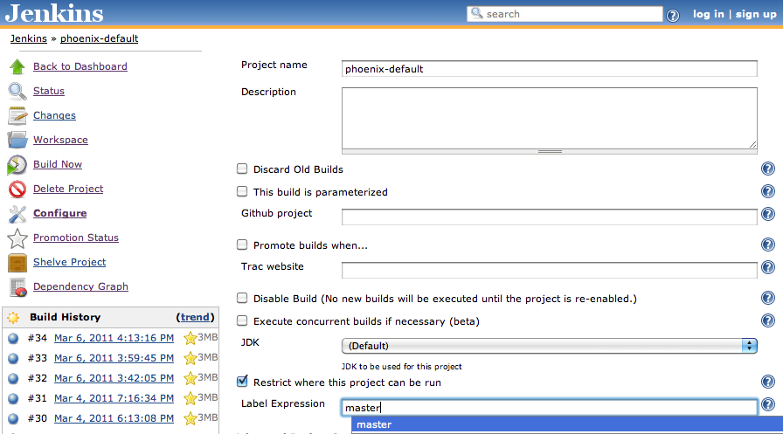
Associating a Build Job with a Slave or Group of Slaves
By default, Jenkins uses the first available slave node for optimal overall turn-around time. However, you can also configure Jenkins to use a particular slave machine to build jobs.
Follow the steps below:
Select the Restrict where this project can be run checkbox in the build configuration page.
Enter the name of the machine or a label of a group of machines in the Label Expression field.
Select the machine from the dropdown list.
Notes:
Trainer Notes:
Explain all the points to the learner

Slide 24
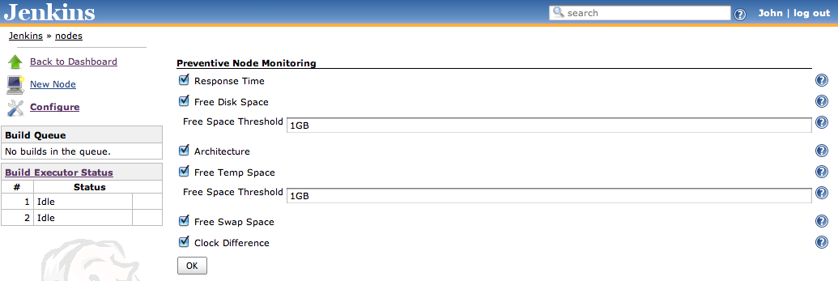
Node Monitoring
The different ways Jenkins monitors the slave agents are:
Response time: A slow response time can indicate either a network problem or that the slave machine is down.
Disk space: Temporary directory space and swap space are available to the Jenkins user on the slave machine based on the complexity and agenda of build jobs.
System clocks synchronization: If the clocks are not correctly synchronized, errors can occur and incorrect reports may be generated.
Notes:
Trainer Notes:
Explain all the points to the learner

Slide 25
Build Jobs with Slave Groups
Problem Statement: You are given a project to build jobs on a slave node in Jenkins.
Steps to perform:
Create slave nodes.
Log in to master node.
Create a new freestyle job.
In the configuration page, check the Restrict where this project can be run option and enter the name of the slave node.
Build job with slave machine.
Notes:
Trainer Notes:
Explain the objective

Slide 26
Jenkins has the capability to execute and dispatch build jobs over a large number of systems.
The number of build servers required can vary during the project life cycle.
The role of Jenkins master job is to schedule build jobs, assign builds to the slaves, record and generate build results.
Labels are tags to a slave node that allow node categorization in Jenkins.

Slide 28
What are the benefits of distributed architecture?
1
Load sharing
More productivity
Both A and B
None of the above

Slide 29
What are the benefits of distributed architecture?
1
Load sharing
More productivity
Both A and B
None of the above
C
Both load sharing and increased productivity are the benefits of distributed architecture.

Slide 30
Where is the build job executed in a master/slave system?
2
On a particular slave machine
On a particular type of machine
Jenkins chooses a random available slave machine
All of the above

Slide 31
Where is the build job executed in a master/slave system?
2
On a particular slave machine
On a particular type of machine
Jenkins chooses a random available slave machine
All of the above
D
A project can be executed on both the master and slave machine of Jenkins.

Slide 32
Where are the build results generated and published?
3
Slave machine
Master machine
Only b
None of the above

Slide 33
Where are the build results generated and published?
3
Slave machine
Master machine
Only b
None of the above
C
Slave machine can generate build results, but it is published only on the master node.

Slide 34
Which of the following tool is NOT a master/slave strategy?
4
Starting the salve machine with SSH
Starting the slave machine with a dedicated master/slave software
Both a and b
None of the above

Slide 35
Which of the following tool is NOT a master/slave strategy?
4
Starting the salve machine with SSH
Starting the slave machine with a dedicated master/slave software
Both a and b
None of the above
B
Only “Starting the slave machine with SSH” is a strategy to start a slave machine.

Slide 36
What should be the username of the slave node while configuring remote access settings?
5
Company’s name
End user’s name
Same as master node’s name
Hostname of the slave machine

Slide 37
What should be the username of the slave node while configuring remote access settings?
5
Company’s name
End user’s name
Same as master node’s name
Hostname of the slave machine
D
Username of the slave machine should be same as the hostname of the slave machine.

Slide 38
Distributed Builds
Problem Statement:
You’re a DevOps engineer at PiperChat, a video chat company that started out as an internal communication tool. PiperChat has since expanded as a popular video calling app with multiple features like various image and voice filters. The company wants to make the build more efficient since the stack has grown. You’re required to configure a master-slave Jenkins architecture to reduce the load on the single Jenkins instance. The company is also considering moving to the Cloud and wants to use this as a pilot. You’re asked to set up a Jenkins slave node on an AWS EC2 machine while retaining the on-prem Jenkins instance as the master.
Requirements:
The app should be built with Maven.
The architecture should have one slave node on an AWS EC2 machine and a local master node.
The master node should only manage slave nodes and all build jobs must be run on the slaves.
Notes:
Trainer Notes: Explain the project to the learners, and instruct them to perform it after the lesson.

Slide 39
Building a CI/CD Pipeline with Jenkin
Project Objective:
Use Jenkins to set up a CI/CD pipeline that will compile and test a Maven project and deploy it to a Tomcat Server.

Slide 40

Background of the Project Statement
You’re a DevOps engineer at Pied Piper, a software company that provides web and mobile app development services. Your team is tasked with building a web app for an online book shop named Bookzy. The developers have decided to use Springboot to generate the project, Maven for compilation, and Git as the Source Code Management system for the project.You’re required to set up a Jenkins pipeline that involves three different freestyle jobs for code compilation, testing, and deployment respectively. Your Pipeline has to poll the SCM nightly for commits, build the project, and trigger the test job if the build is stable. The test job has to run unit tests, publish the JUnit test report, and trigger the freestyle job for deployment. The deployment job is required to package the Maven project, deploy the war file to a Tomcat server, and notify you via email if deployment failed.

Slide 41
You Are Asked to Do
Build the app with Spring Boot and Maven
Set up the Tomcat server on an EC2 instance
Configure the Tomcat server to allow remote deployment
Test and publish the results with JUnit
Build a pipeline with three freestyle jobs for :
Compilation
Test
Deployment

Slide 42

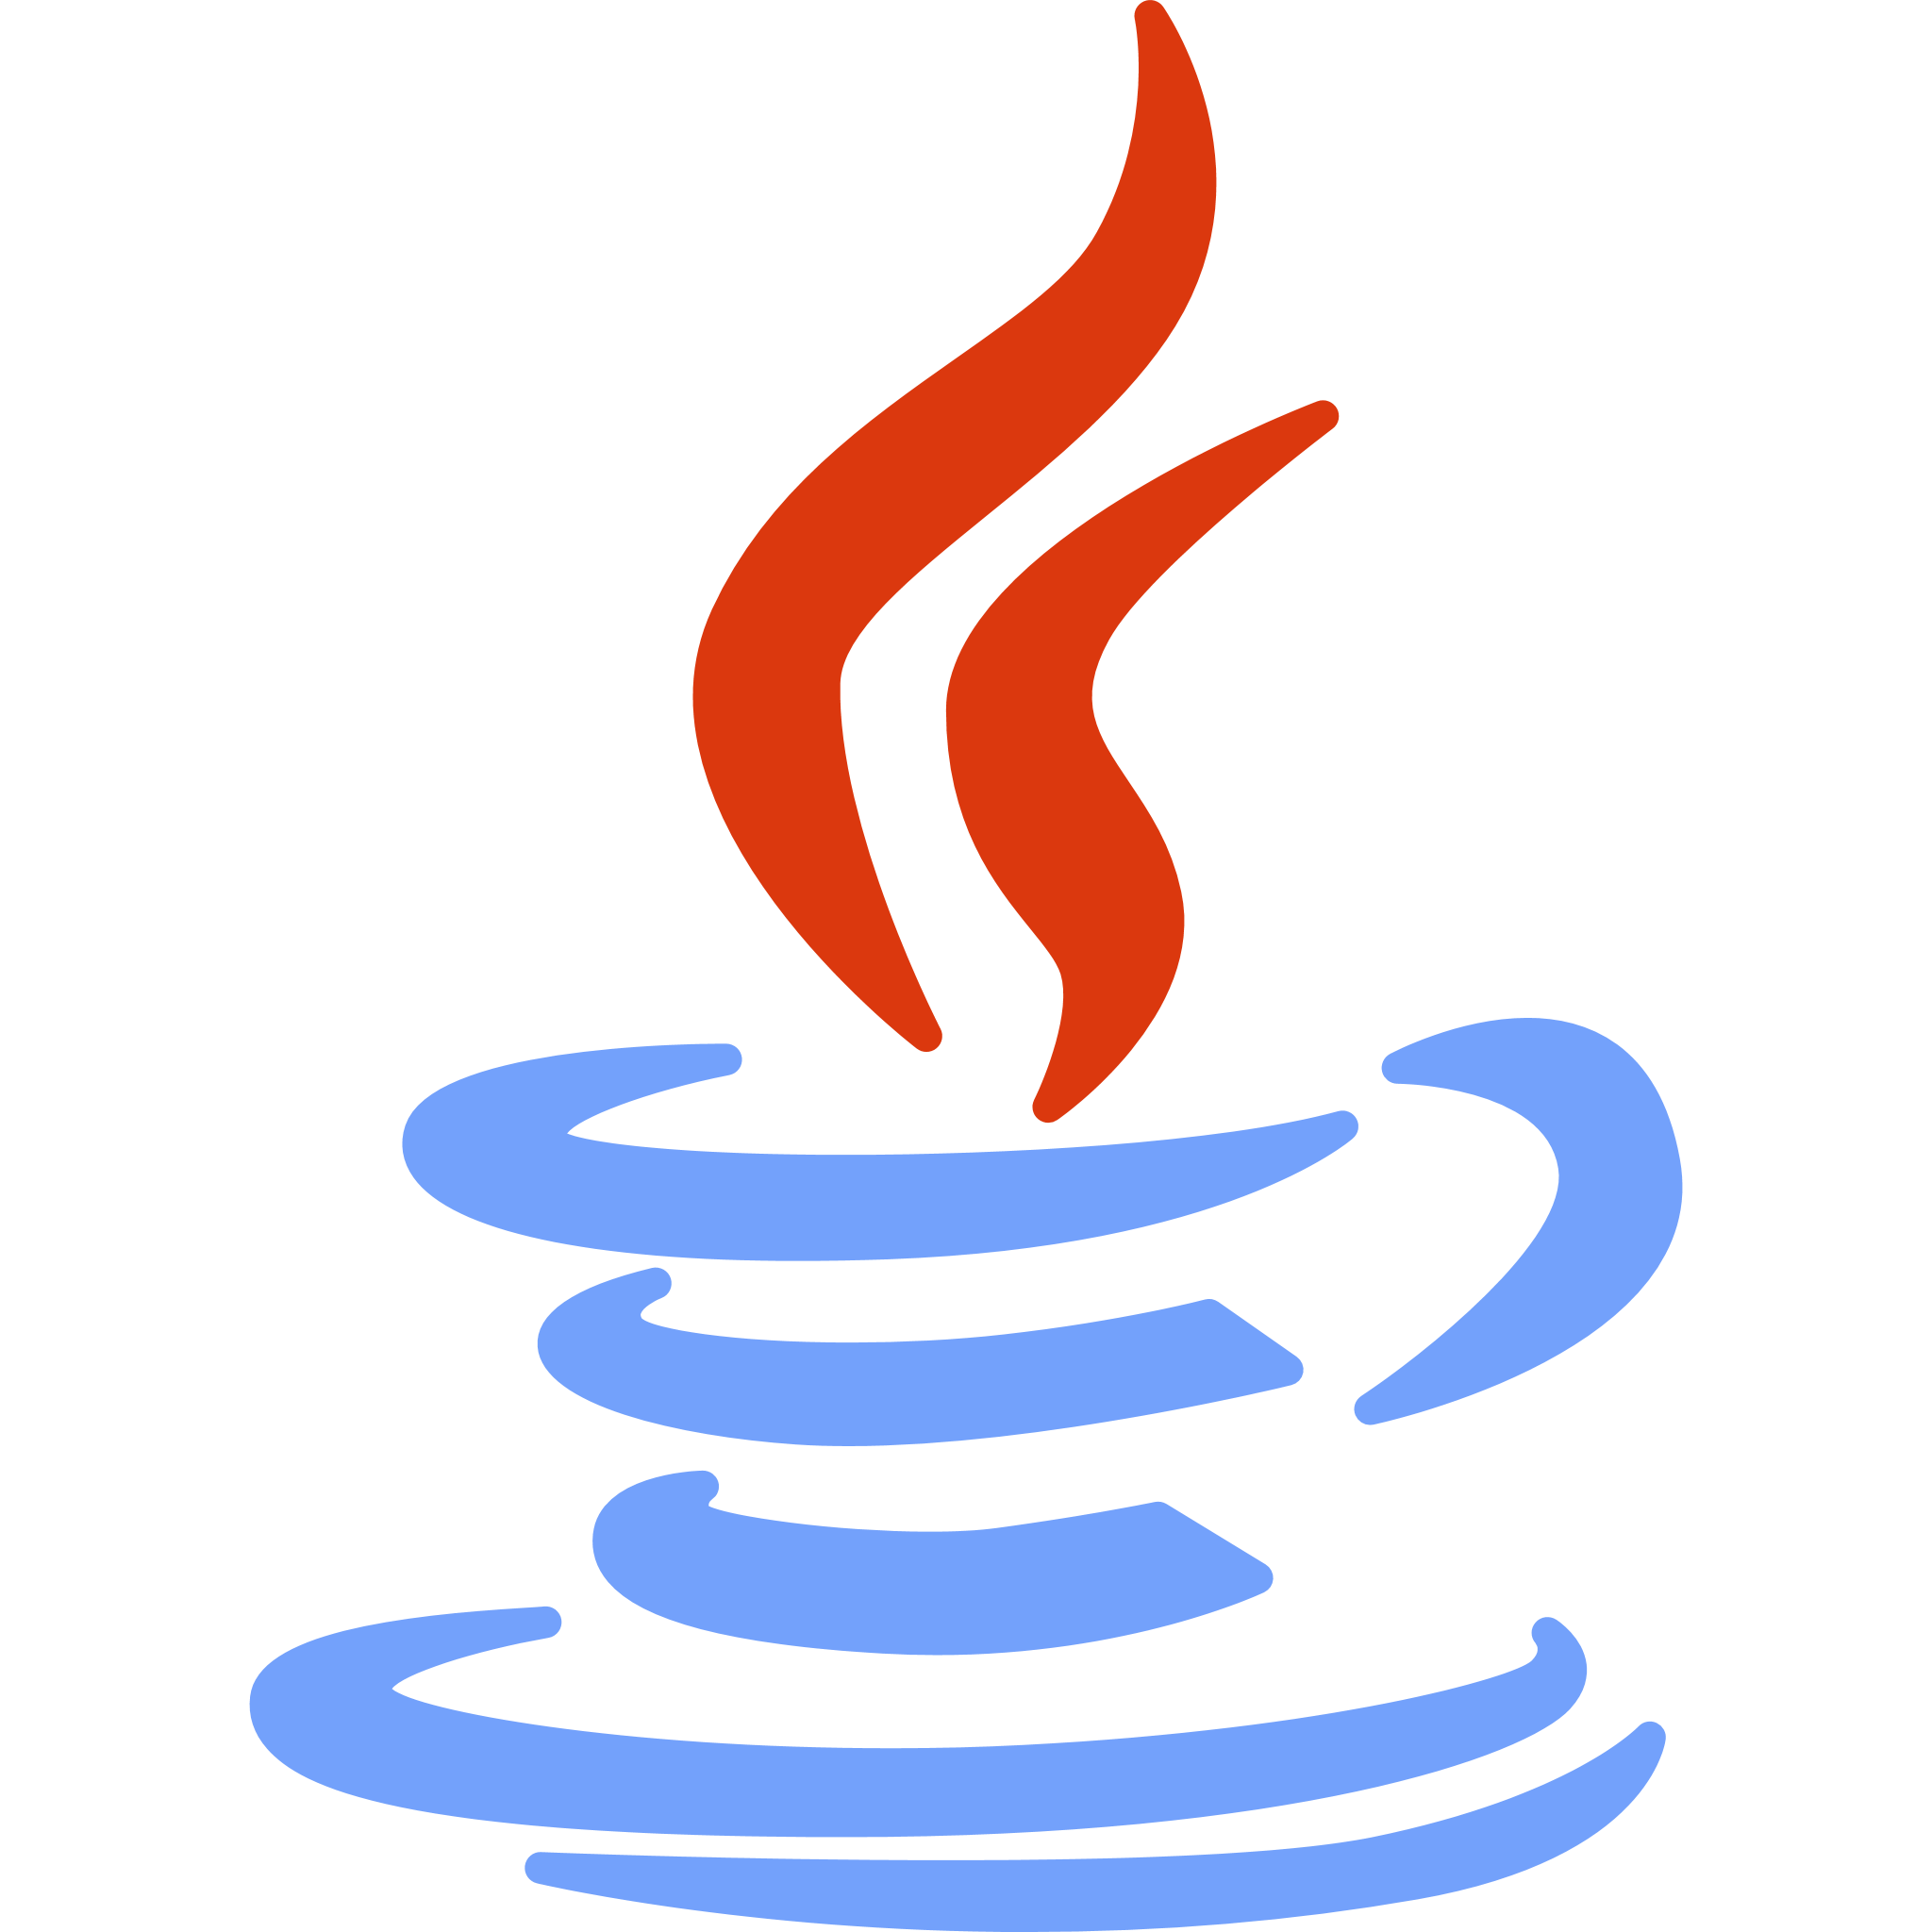





You must use the following
Jenkins
Programming language: Java
Git and GitHub
Spring Boot
AWS EC2
Tomcat

Slide 43
Architecting Jenkins Pipeline for Scale
Project Objective:
Use Jenkins to set up a distributed pipeline that will compile and test a Maven project on two different slave nodes respectively.

Slide 44
Background of the Project Statement
You’re a DevOps engineer at Softmax Solutions, a software company that develops image filters for various photo enhancement apps. It is undergoing an infrastructural change to implement DevOps in its development process. The company uses git as their Source Code Management System and AWS for hosting its servers. You’re required to architect a scalable Jenkins Pipeline for building and testing the software stack. You’re tasked with designing a Jenkins architecture that involves one master and two slave nodes, all hosted on various AWS instances. The build jobs should always be triggered by the master and executed on the slaves. You have to set up a pipeline on the master node and write a Groovy script that clearly differentiates the tasks to be run on various slaves.

Slide 45
You Are Asked to Do
Build the app with Spring Boot and Maven
Set up three EC2 instances to host the Jenkins architecture
Configure a master node to trigger and monitor all builds
Set up dedicated slave nodes for testing and compiling
Define a Jenkinsfile that marks each node and their functions
Build a pipeline with three stages:
Checkout
Compilation
Test

Slide 46

You must use the following
Jenkins
Programming language: Java
Git and GitHub
Spring Boot
AWS EC2
Maven

